Slide 1
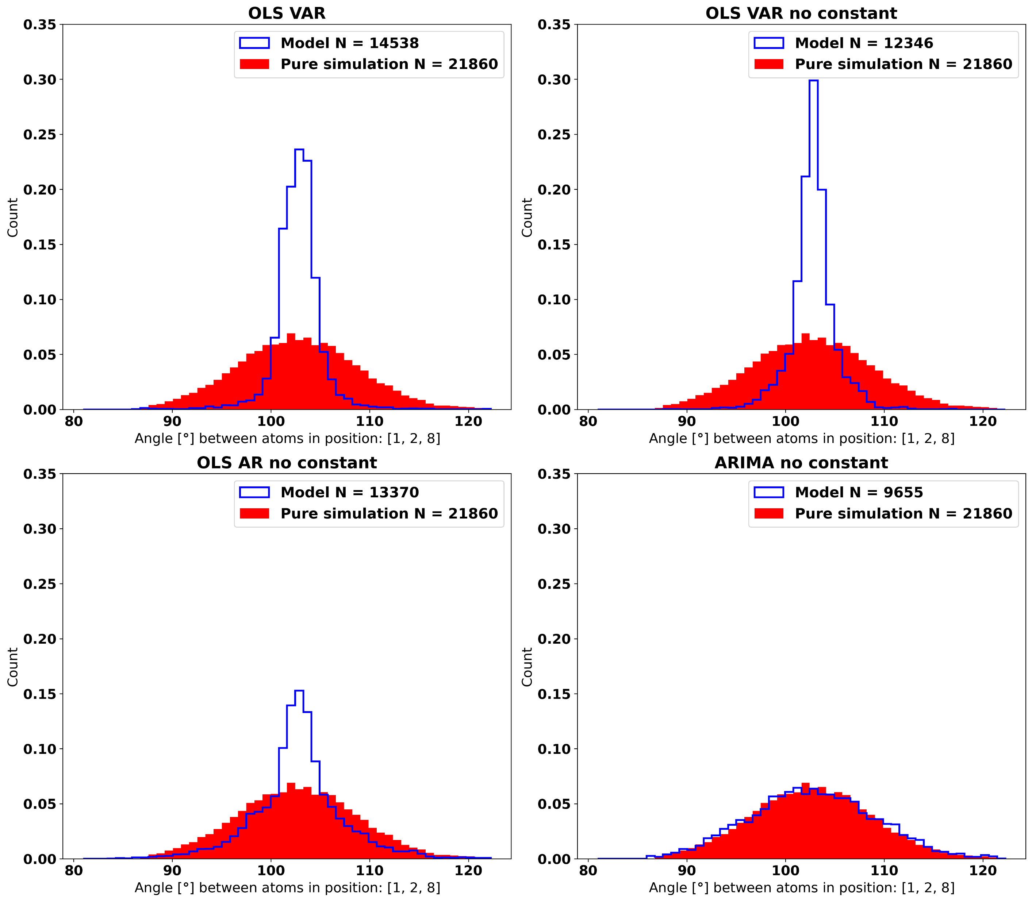

Slide 2
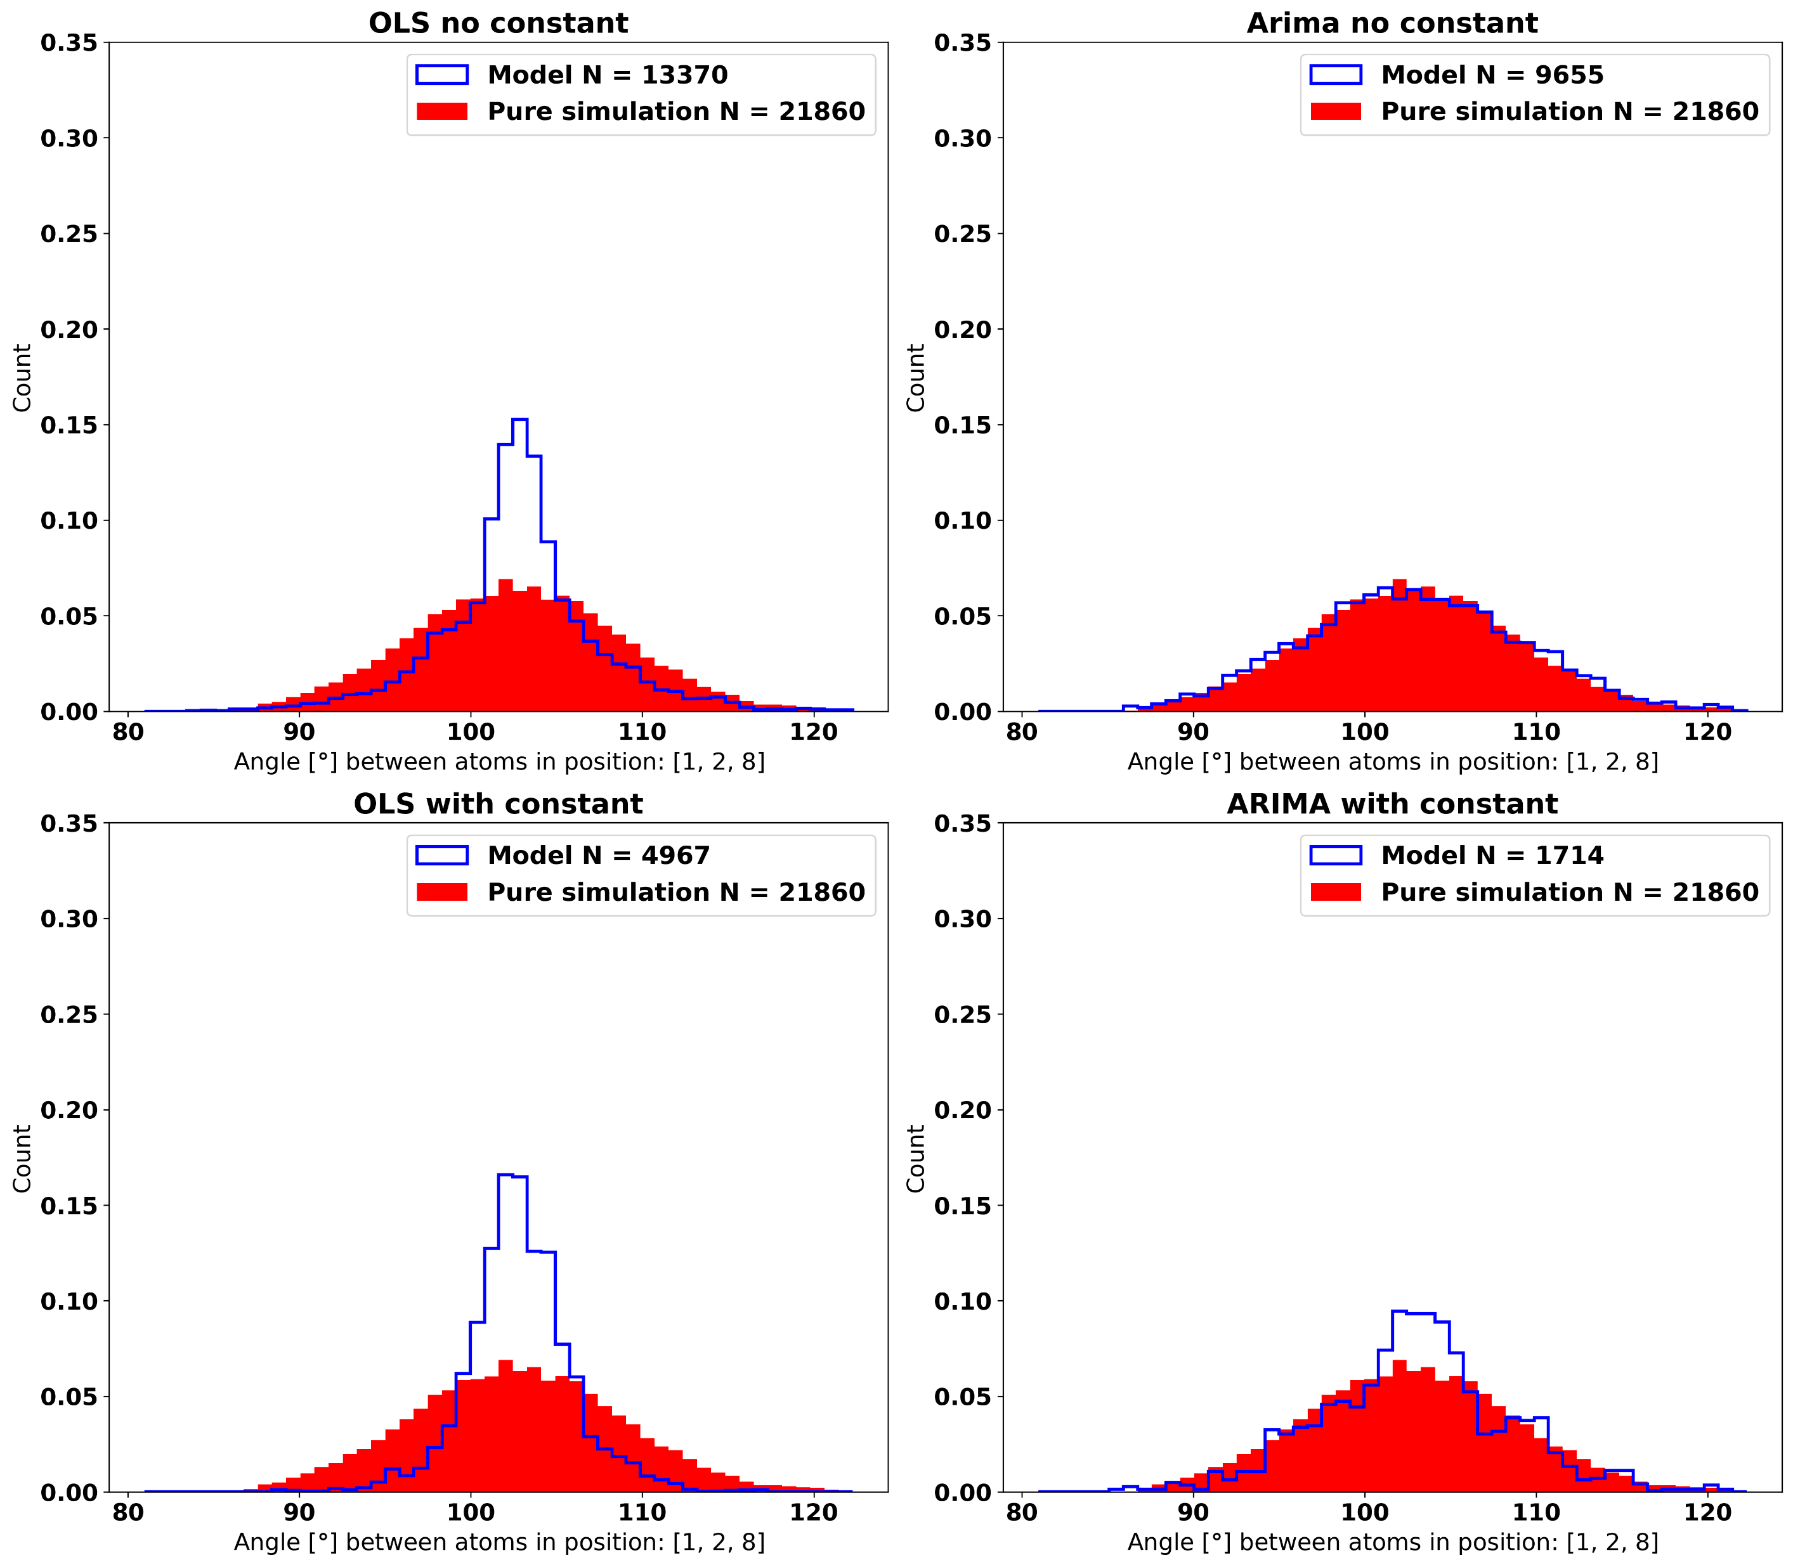

Slide 3
KS score of 0.034

Slide 4
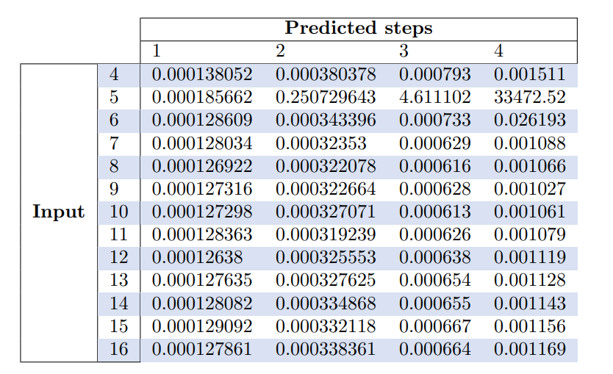
Grid search for hyperparameters

Slide 5
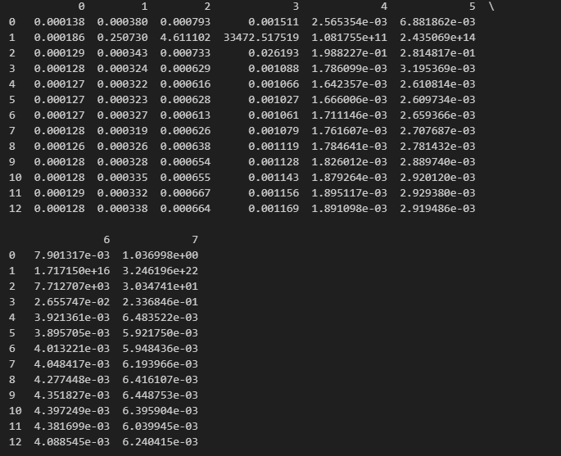
Grid search for hyperparameters

Slide 6
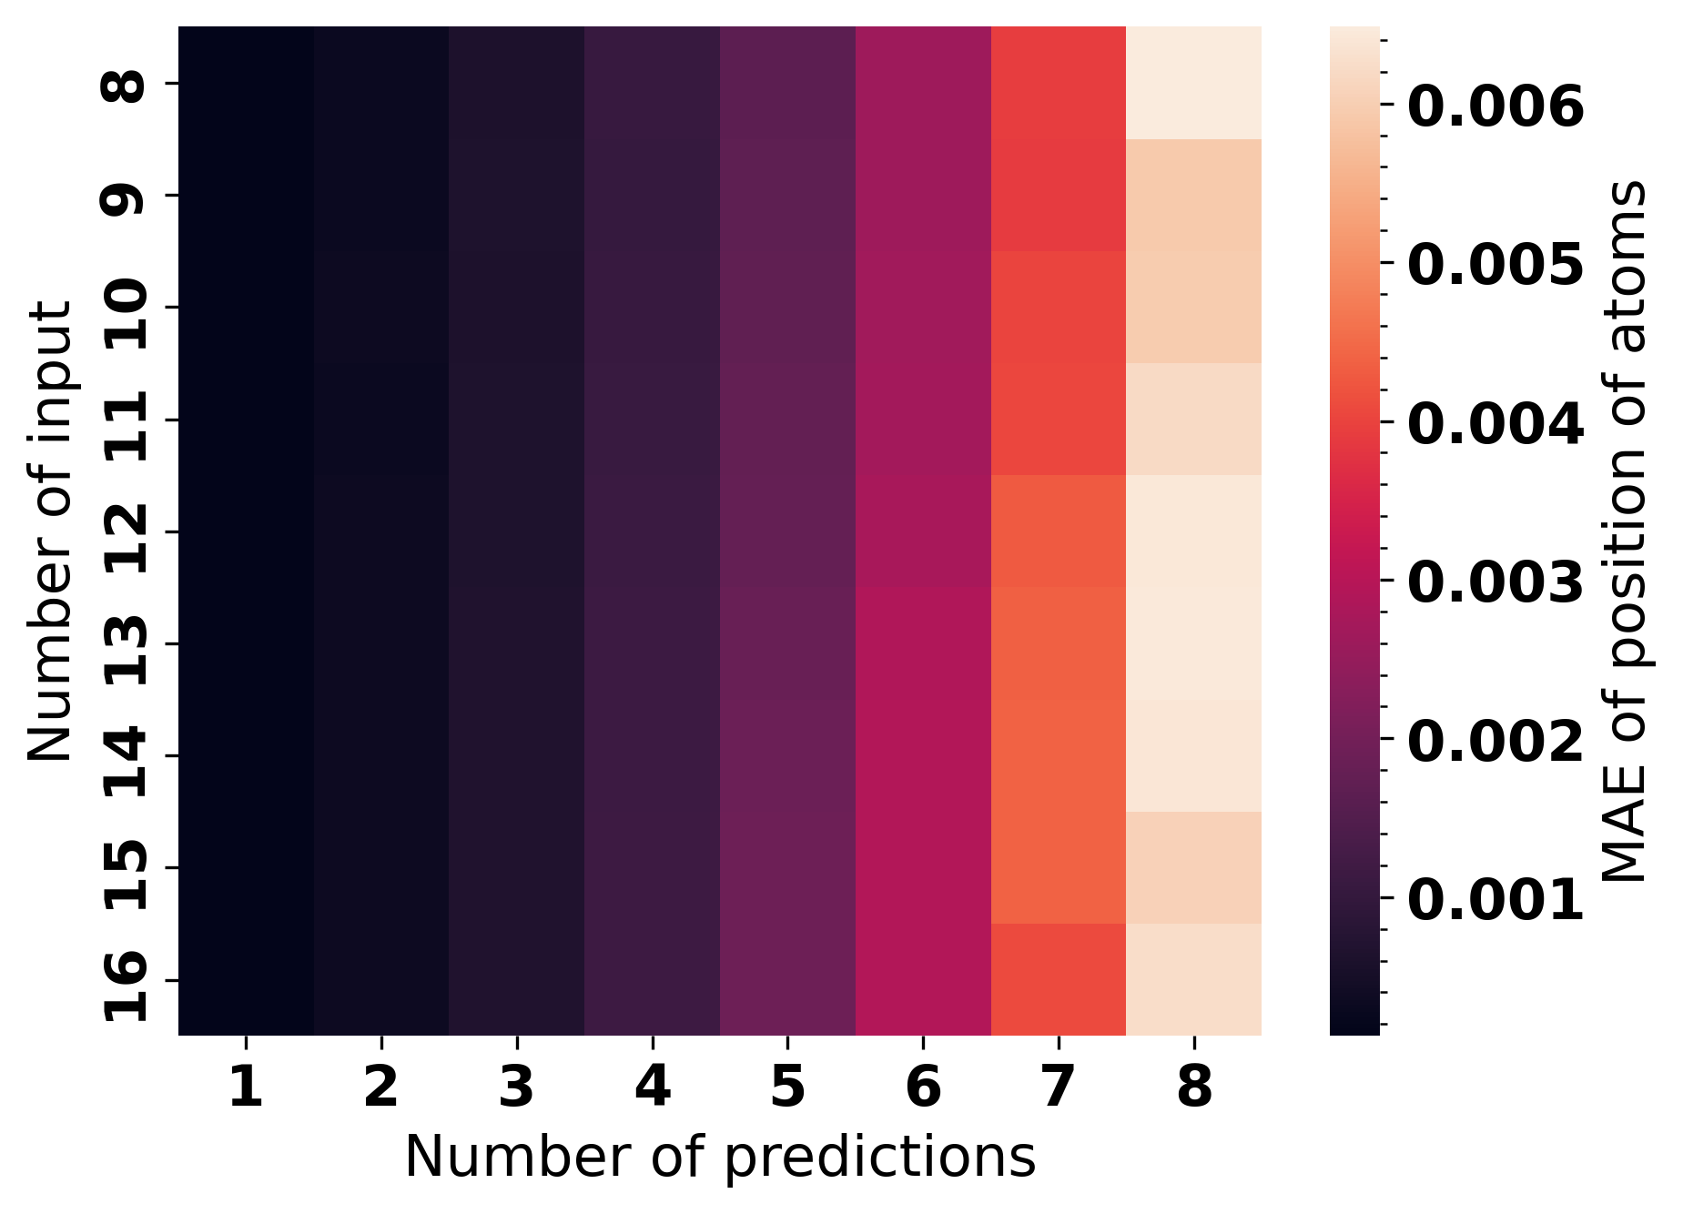
Grid search for hyperparameters

Slide 7
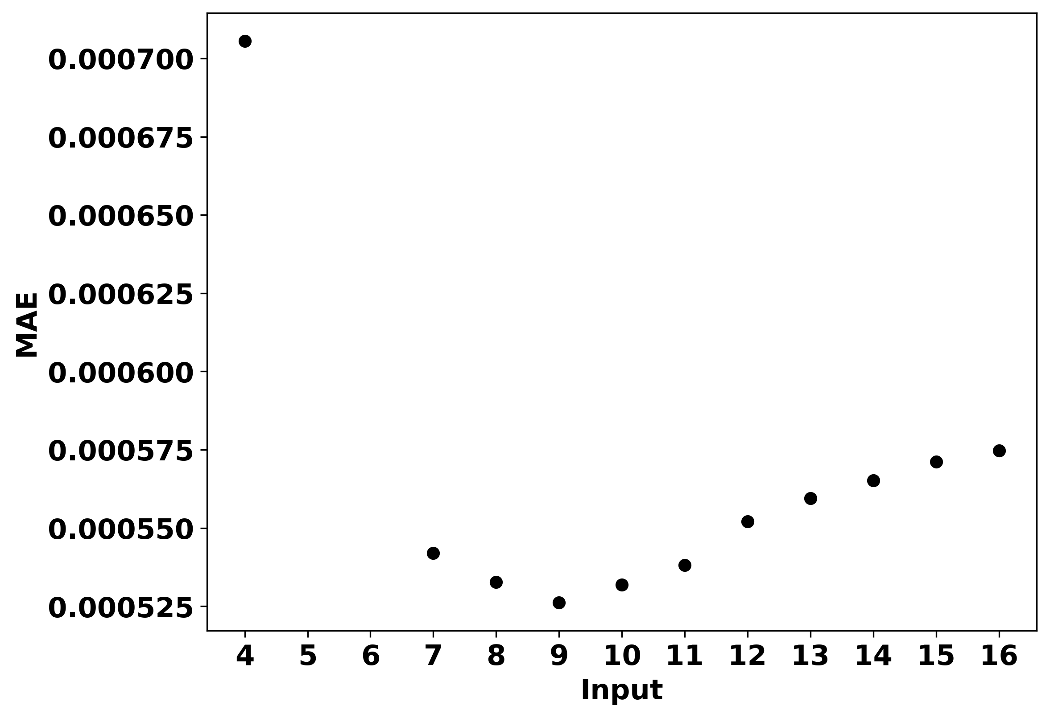
Effect of input on MAE, max pred=4

Slide 8
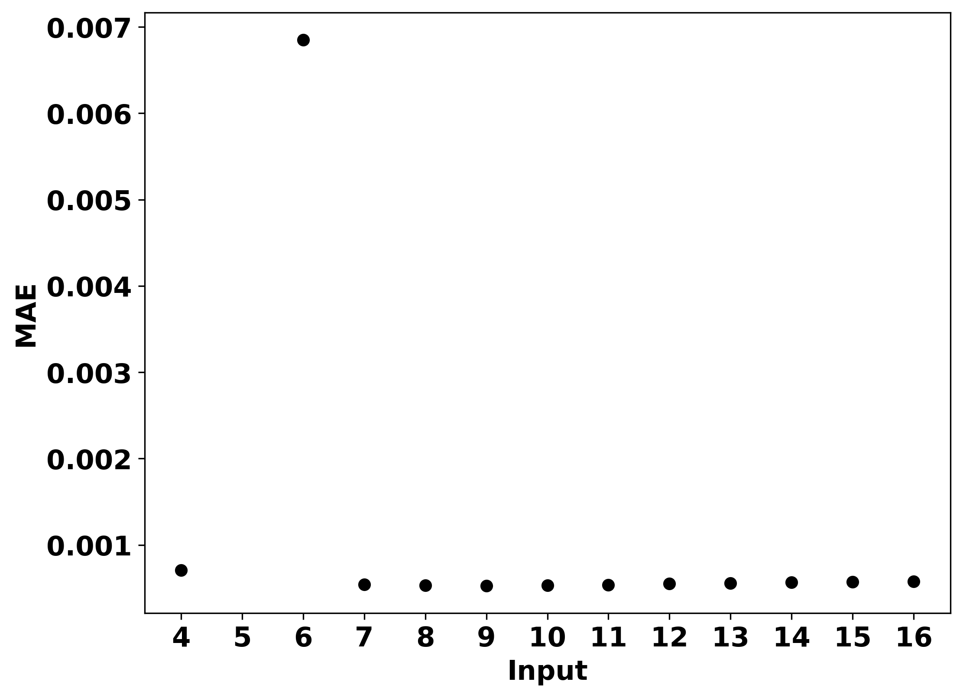
Effect of input on MAE

Slide 9
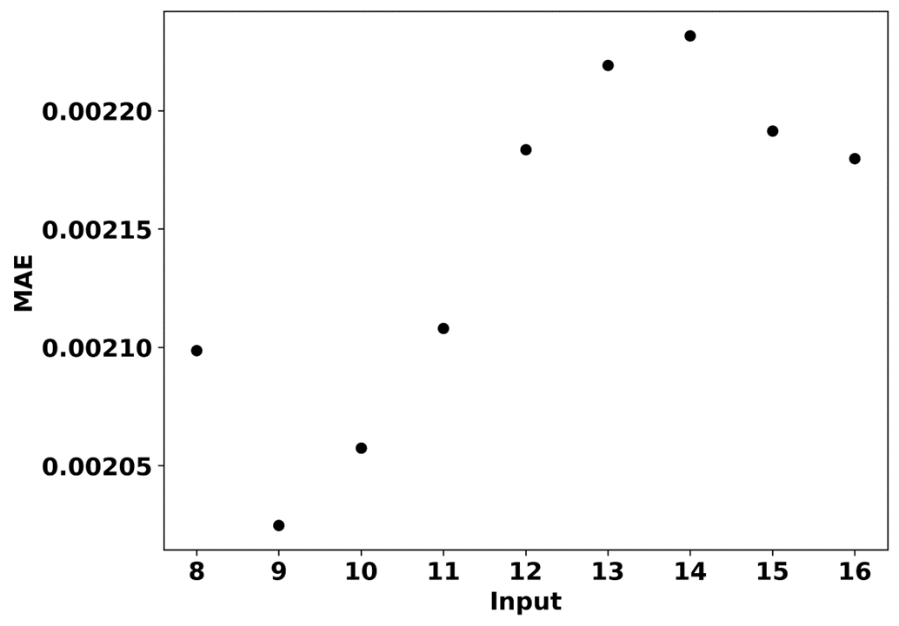
Effect of input on MAE, max pred=8

Slide 10
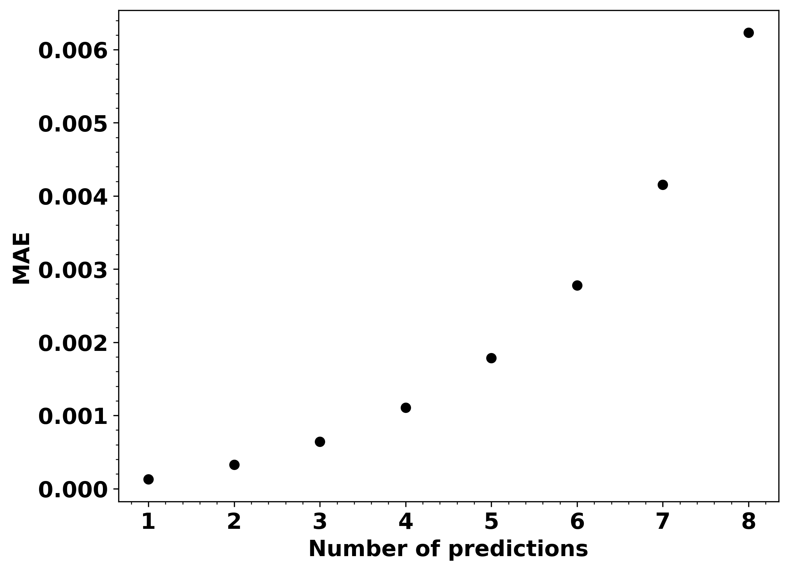
Effect of number of predictions on MAE

Slide 11
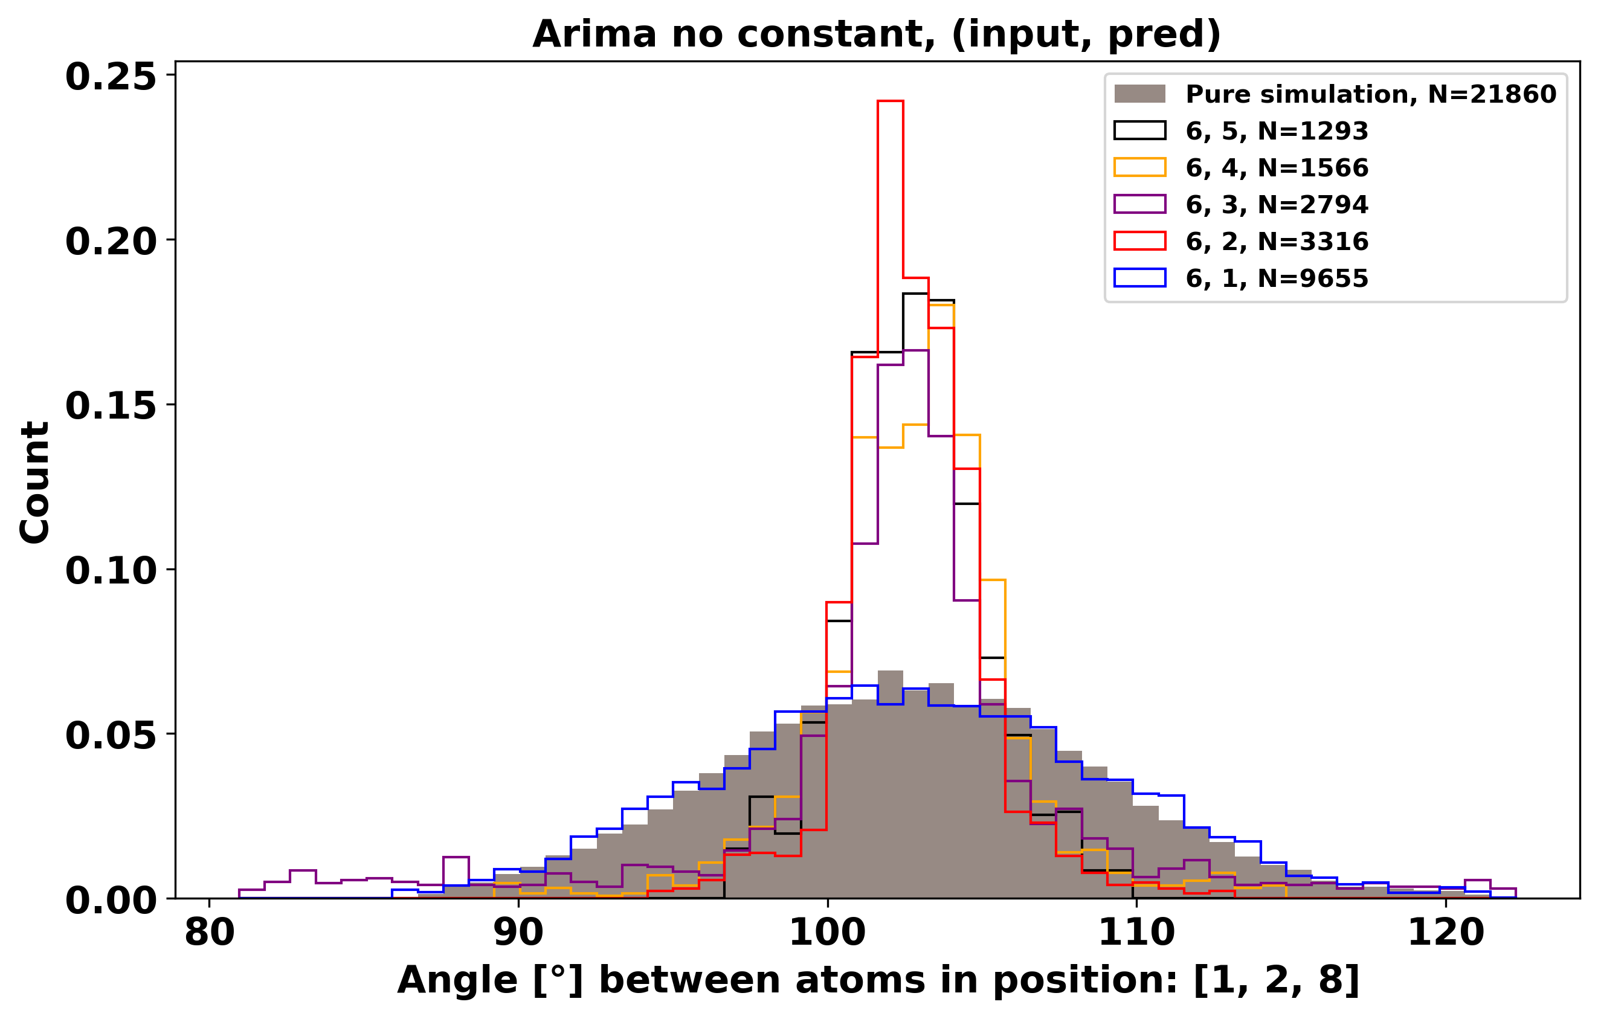
ARIMA Models with different number of predictions
Higher number of predictions might perform better with regularization

Slide 12
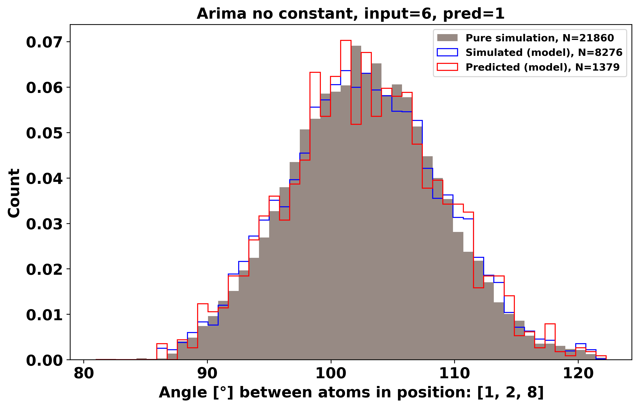
Check how it looks with higher prediction

Slide 13
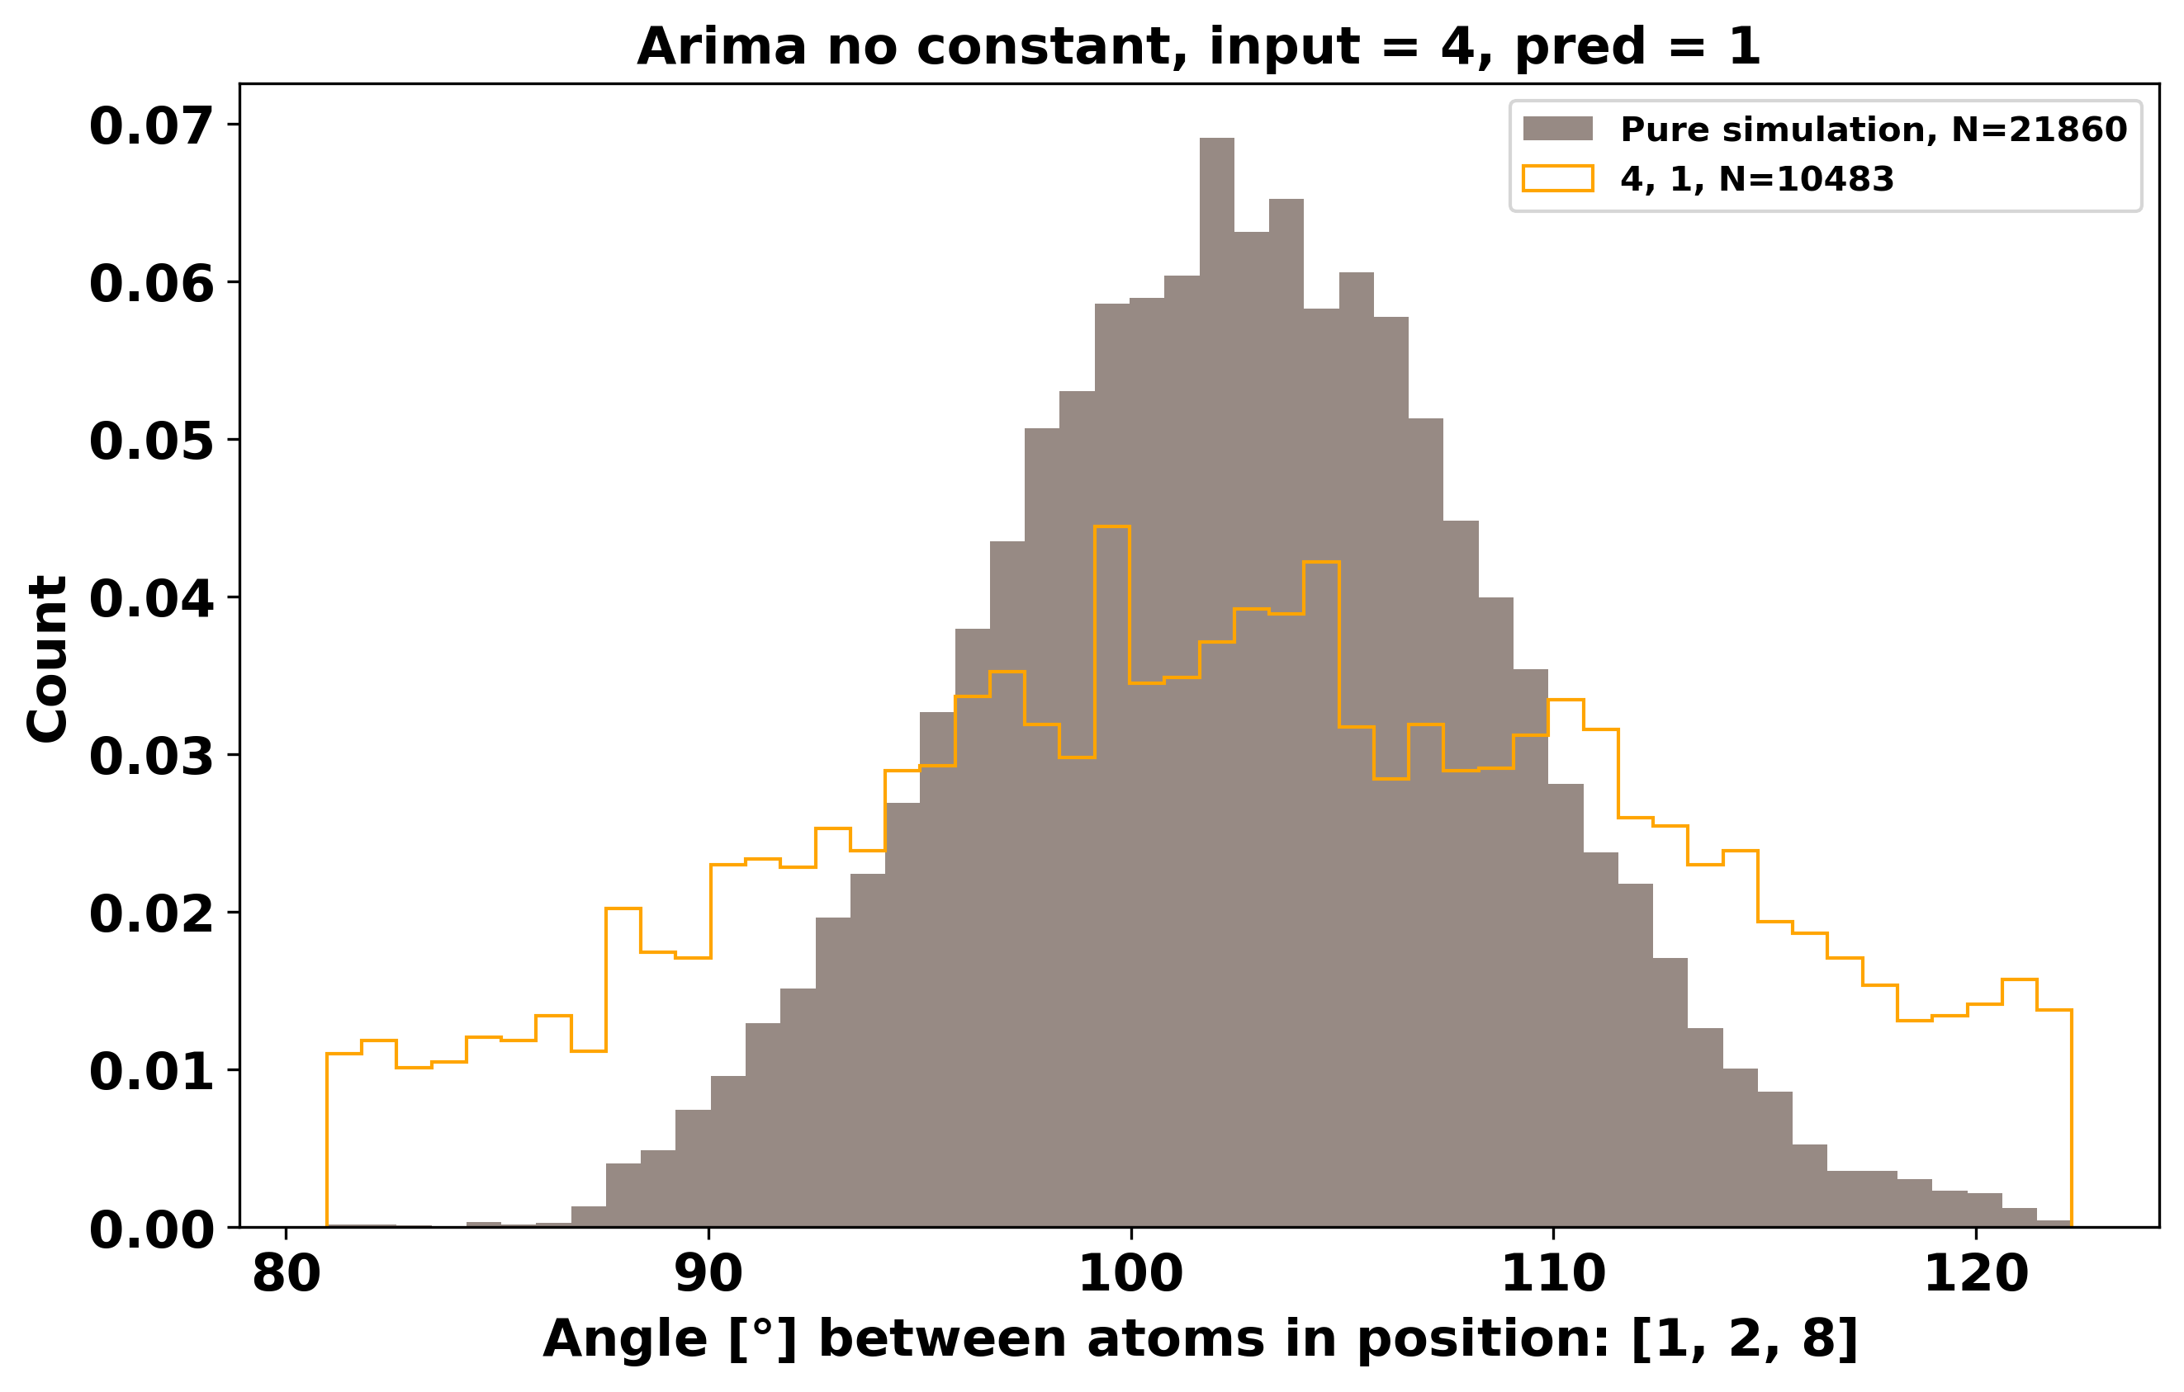
ARIMA Model with input = 4, pred = 1

Slide 14
Issues with simulations incorporating model (input, pred)
(4, 1): LU decomposition error (statsmodels)
(6, 2): LU decomposition error (statsmodels)
(6, 3): LU decomposition error (statsmodels)
(6, 4): LU decomposition error (statsmodels)
(6, 5): LU decomposition error (statsmodels)

Slide 15
Future tasks/problems
ARIMA model does not always converge
No Regularization on ARIMA
LU Decomposition when fitting model
Seeing how input = 8 works
Check the distribution of parameters in the models for posibility of choosing better starting parameters?

